Slide 1



WW-FINGERS
Prof. Miia Kivipelto, MD, PhD Managing Director & Director of Research and Development
Karolinska Institutet, NVS, Center for Alzheimer Research
Karolinska University Hospital, Aging Theme
University of Eastern Finland
Notes:
Thank you for the organizers for the invitation, it is a great pleasure to be here and talk about the FINGER trial which is one of the first large multidomian lifestyle based interventions aiming to prevent cognitive impairment.

Slide 2


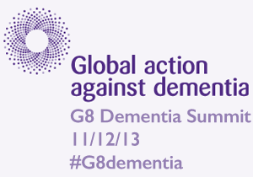
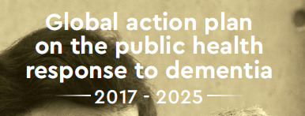
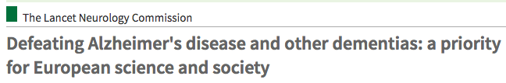

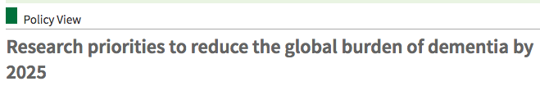
Dementia prevention: global priority
WHO Dementia Risk reduction guidelines2018
WHO Ministerial Conference on Global Action Against Dementia, 2015
2016
2016

Slide 3
Dementia and Alzheimer disease: importance of multidomain approach
RISK FACTORS
MECHANISMS
Unhealthy diet, Alcohol misuse,
Smoking, Diabetes, Depression
Neuronal damage
Vascular insults
APOE,
other genes
High blood pressure
Obesity
High blood cholesterol
Familial aggregation
Adult life
Mid-life
Late-life
DEMENTIA
0
20
60
75
Education
Transition
Brain reserve
Cognitive reserve
Physical activity,
Cognitive & social activity
PROTECTIVE FACTORS
MECHANISMS
Modified from Kivipelto, Mangialasche et al., Oxford Ger Text Medicine 2017, Nature Neurology (in press)
Notes:
Can we do something to prevent dementia and AD? We have increasing evidence from epidemiological studies linking various modifieable factors througout the whole life course to dementia. Vascular risk factors. Diabetes, Lifestyle factors like diet and smoking. Protective factors including active lifestye. More optimistic pictute; several targets & time windows for interventions.

Slide 4

Presented at AAIC 2014
INTENSIVE INTERVENTION
Nutrition
Exercise
Cognitive training
Vascular risk monitoring
N= 1260 60-77 years
years
2
REGEULAR HEALTH ADVICE
Notes:
Communication! Info seminars for participants. News letter, post cards.
Det har varit svårt att bevisa med interventionsstudier att det gåt att förebygga/behandla…
Här måste du betona att du är PI!!! Senaste 7-8 åren, Från observation to action. Många negativa demens RCTs. FINGER – världens första stora multidomän intervention…..
Vi har nyligen blivit färdiga med värdens första stora interventionsstudie FINGER där vi försökte ändra flera livsstilsfaktorer samtidigt och huvudsyfte var att förebygga minnesproblem
Vi hade totalt 1260 personer, 60-77 år. Hälften fick kostråd, fysisk aktivitet, minnesträning och hantera blodtryck, kolesterol, fetma, diabetes. Hälften får vanligt råd. Redan efter 2 år såg vi tydliga skilnnader; Mycket positiva effekter på minnesförmågan, snabbhet, planeringsförmåga. Starkaste bevis hittils – går att förebygga minnesårproblem
Mycket uppmärksamhet.

Slide 5

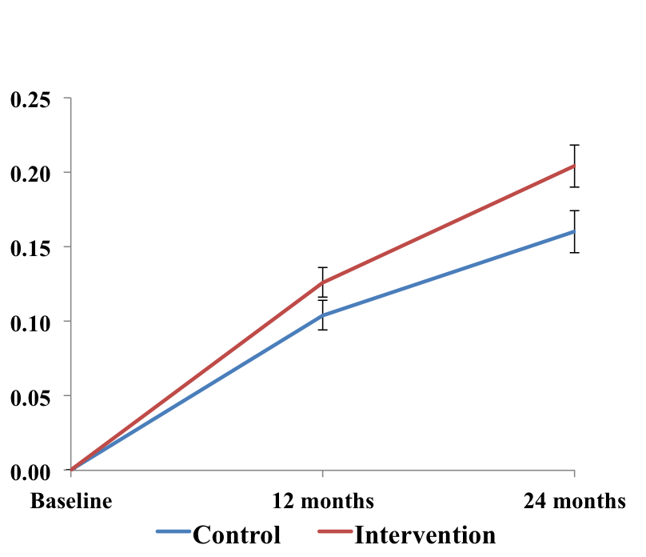
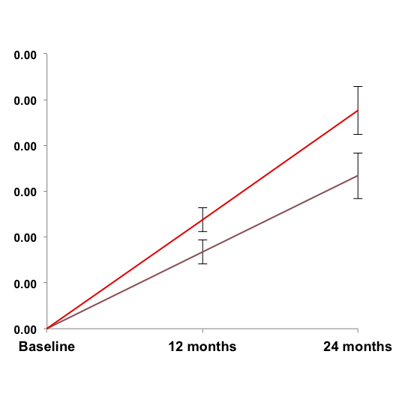
Summary of primary findings
Primary: NTB total score
(Composite z-score)
p=0.03
p=0.04
p=0.03
25% higher improvement
83% higher improvement
150% higher improvement
Memory (complex tasks)
Red - intervention
Blue - control
Lines = estimates for change from baseline to 1 & 2 years
Error bars = standard errors
P-values = difference in trajectories over time between groups
Lower risk for cognitive decline
30% lower risk for functional decline (IADL) (Kulmala et al., manuscript)
Better health related quality of life (Strandberg et al, Eur Ger Med 2017)
p=0.04
Ngandu, Kivipelto et al. Lancet 2015
40% higher improvement
Notes:
This is a summary of the primary findings.
The FINGER intervention had significant benefits on the primary cognitive outcome
And also on executive functioning, processing speed, and memory (assessed with more complex tasks).

Slide 6
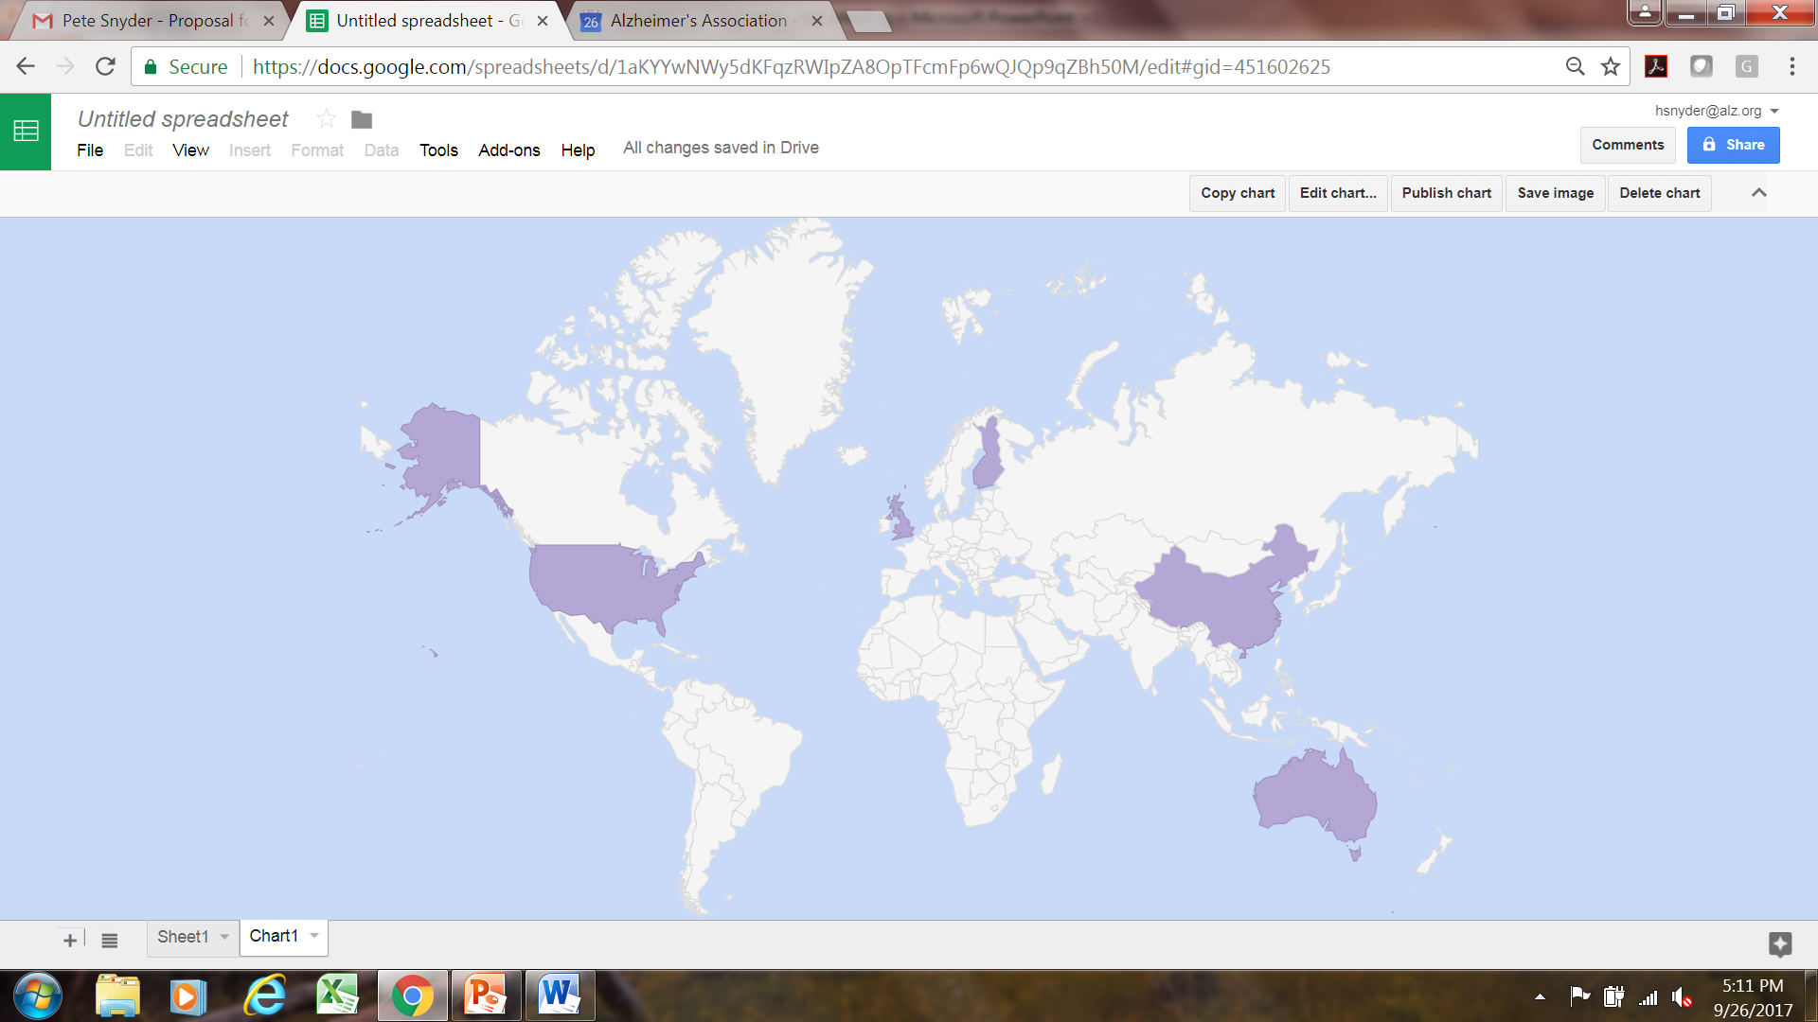
World Wide FINGERS (WW-FINGERS)
Launched at AAIC 2017
FINGER
Canada
U.K. FINGER
U.S. POINTER
MIND
FINGER
Germany, Spain, Italy
Japan
Mexico
India
SINGER
Maintain Your Brain
Argentina
http://wwfingers.com
Notes:
Not only are we an integral part of the exciting landmark U.S. POINTER study, but we are host organization to bring the world wide efforts together through WW-FINGERS.
US, UK, Singapore, Australia and the original Finland team.
New Countries in the planning phase: India, Germany, Spain, Italy, Canada

Slide 7

World Wide FINGERS (WW-FINGERS)
MIND-CHINA
? ? ?
US-POINTER
FINGER
? ? ?
? ? ?
SINGER
? ? ?
? ? ?
UK-FINGER
Core Methods
Implementation
- Multidomain, pragmatic, individualised intervention
- Group & individual sessions
- Common outcomes
-Cultural & local adaptations
- Knowledge dissemination
- Translation to practice
http://wwfingers.com
Notes:
Not only are we an integral part of the exciting landmark U.S. POINTER study, but we are host organization to bring the world wide efforts together through WW-FINGERS.
US, UK, Singapore, Australia and the original Finland team.
New Countries in the planning phase: India, Germany, Spain, Italy, Canada

Slide 8








U.S. Study to Protect Brain Health Through Lifestyle Intervention to Reduce Risk (U.S. POINTER)
Target population 60-79 y, n 2000, normal cognition but increased risk
2-year intervention
Global cognitive composite outcome
Self-Guided Lifestyle Intervention
Structured Lifestyle Intervention
Exercise (mostly aerobic): 4x per week primarily at a YMCA
Nutrition: MIND diet (modified Mediterranean)
Cognitive Stimulation: Computer cognitive training (Posit Science), group meetings to encourage social/intellectual challenge
Education & Support: Group meetings 2-3 times per year for presentations and support, general information about healthy lifestyle
Guideline-Based Health Coaching: Frequent exams, blood tests, review of health numbers & goal-setting
Guideline-Based Health Coaching: Annual physical exam & blood tests
Notes:
Room for risk reduction

Slide 9

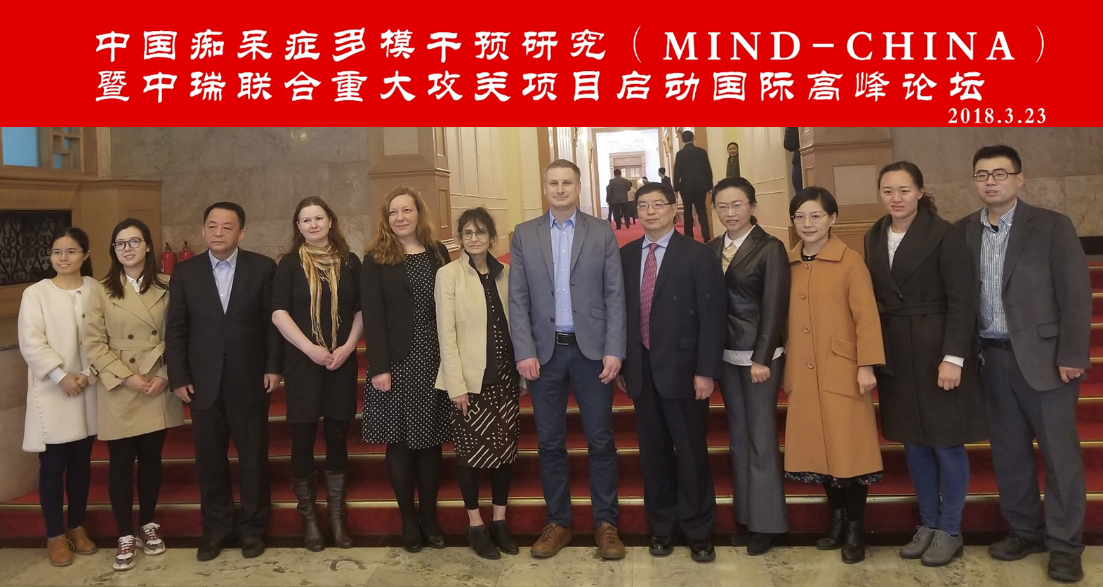

A randomized controlled Multimodal INtervention to delay Dementia and disability in China (MIND-CHINA):
Target population 60-79, n~3000
Cluster randomization (by village)
Baseline examinations ongoing
MRI substudy n~ 1000
Qiu C, Du Y et al,
Control Group
Control Group
Regular health care service
Phamacological control of major VRFs:
Antihypertensive, antidiabetic, statins, antiplatelet drugs
Vascular Intervention Group
Multimodal Intervention group
Domains of intervention:
Healthy lifestyle; diet (salt); social/physical activities; cognitive training
Multimodal Intervention Group

Slide 10

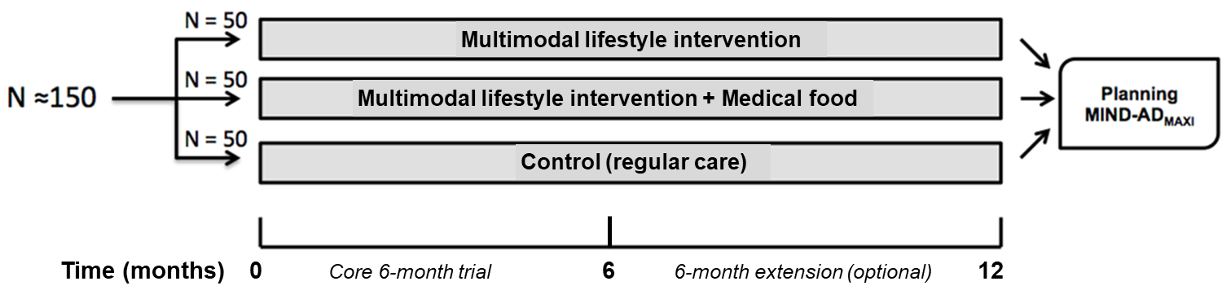









Multimodal preventive trials for Alzheimer’s Disease - MIND-AD
Target group: prodromal AD + vascular + lifestyle risk factors
Tools for combined prevention trials: lifestyle + disease-modifying drugs
Intervention: combination of lifestyle + medical food
(Soininen et al, Lancet Neurol. 2017)
Notes:
Good bases for the studies and initiatives. Goal guidelines international actions
Building upon the experience from FINGER, and the other ongoing multidomain RCTs, we recently launched the MIND-AD project (Multimodal preventive trials for Alzheimer’s Disease: towards multinational strategies), several European countries. in which a multimodal intervention will be tested in subjects with prodromal (early-symptomatic) AD, for whom there are currently no therapeutic options (we are lacking evidence based interventions). The pilot will study after summer; 1) multi-modal lifetstyle, 2) multi + medical food, 3) control. Feasibility + adherense, seamless continuation to maxi, biomarkers and cognition.
Harmonize methodoligical issues in preventive RCTS. Guidelines and recommendations. Our final goal is to contribute in defining effective preventive measures for individuals with different risk profiles for dementia and AD.
“Our final goal is to contribute in defining effective preventative measures,”

Slide 11

Data harmonization
COGNITIVE
CLINICAL
LIFESTYLE
GENETIC
NEW: GWAS in clinical trials
BLOOD MARKERS
NEW: Omics in clinical trials
BRAIN IMAGING
MRI, PET
CSF MARKERS
WW-FINGERS biorepository
Introducing bioinformatics approach
Notes:
Quantifying dementia risk and prevention potential in clinical trials. Dementia risk scores/dementia predicton algoritms.

Slide 12


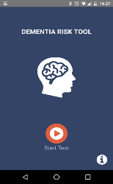

Impact: Personalised & effective dementia prevention
An interdisciplinary global network and consortium to:
Share experiences, research ideas and data
Harmonize research methods in prevention trials
Facilitate synergistic use of multinational data
Plan joint dementia prevention initiatives
Generate robust evidence on effective preventive approaches for various at-risk groups and settings
Rapidly implement knowledge
Formulate recommendations and guidelines for dementia prevention and future trials
US-POINTER
MIND-China
SINGER
MYB
MIND-AD
(FI, SE, FR, DE)
…
UK-FINGER
E-helath & M-health tools
MULTI-MODE
Notes:
The Brain Health Toolbox (Figure 1) is designed to create a seamless continuum from accurate dementia prediction to effective prevention. This creates a unique possibility for deeper phenotyping of AD and identifying accurate disease models and prediction tools for personalized decision-making for dementia prevention.
The main hypothesis is that tailored multimodal interventions (e.g. non-pharmacological, or combined non-pharmacological and pharmacological modalities) are most effective for preventing/delaying dementia onset.
There is a bidirectional relation between the Brain Health Toolbox and the World Wide FINGERS trials. This is essential because the Toolbox is not meant to be rigid and operate in a vacuum, but has to be flexible and closely attuned to real-life prevention needs. Critical points for success are: i) conducting a sufficient number of WW-FINGERS trials to ensure worldwide representativeness; and ii) guaranteeing added value and synergy, i.e. more than a sum of disjointed tools for disjointed trials

Slide 13


















Acknowledgements
Grant support: Alzheimer Association, MetLIfe, Academy of Finland, Swedish Research Council, ALF grants, Social Insurance Institution of Finland, Ministry of Education and Culture of Finland, Novo Nordisk Foundation, Alzheimer’s Research and Prevention Foundation, EU 7th framework, AXA Research Foundation, CIMED, JPND, IMI, EiT-Health, Wallenberg Clinical grant, Stiftelse Stockholms Sjukhem
All teams
FINGER
US-POINTER
SINGER
UK-FINGER
Unit for Clinical Trials
MIND-CHINA
Turku PET Centre

Slide 14

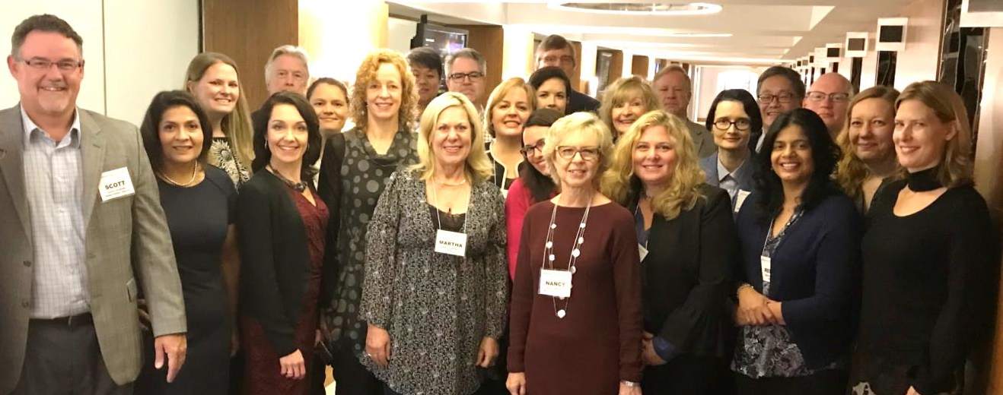
U.S. Study to Protect Brain Health through Lifestyle Intervention to Reduce Risk
Study Team
Wake Forest: Laura Baker, Mark Espeland, Jeff Williamson, Nancy Woolard, Jing Su, Scott Rushing, Jeff Katula, Julia Robertson, Iris Leng, Dan Beavers, Jo Cleveland
UC Davis: Rachel Whitmer, Charlie DeCarli, Sarah Farias
FINGER team: Miia Kivipelto, Tiia Ngandu, Alina Soloman
Industry Partners:
Posit Science
Digital Cognition Technologies, Cogstate
Wellpepper, FitBit, YMCA
Rush University: Martha Clare Morris, Jennifer Ventrelle
USC/ATRI: Rema Raman, Gustavo Jimenez,-Maggiora Robert Rissman
Brigham & Women’s Hospital/Harvard: Kathryn Papp, Dorene Rentz
Y-USA: Valerie Lawson
Alzheimer’s Association: Maria Carrillo, Heather Snyder, Bill Fisher, Glenda Berry, Kenann Cassidy, Elizabeth Edgerly, Katherine Lambert, Claire Day

Slide 15
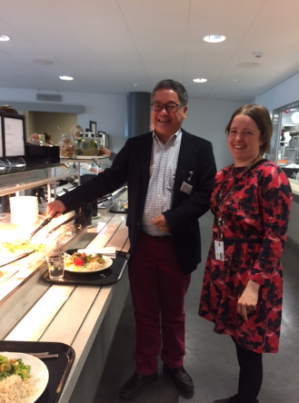
SINGapore intervention study to prevEnt coGnitive impairment and disability (SINGER) study
RCT of multidomian interventions in elderly patients at risk of cognitive decline
Cognitive (X Xu)
Diet (CJ Henry)
Exercise (E Chew)
Vascular risk modification (C Chen)
Target population: at risk/MCI
N ~150
Duration 6 months Feasibility study prior to larger scale study (funded by NUS Centre for Healthy Ageing)
FINGER vs SINGER adaptations

Slide 16

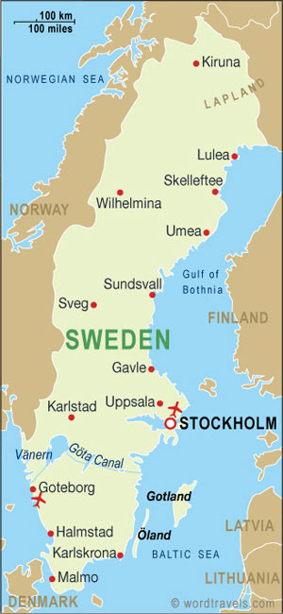
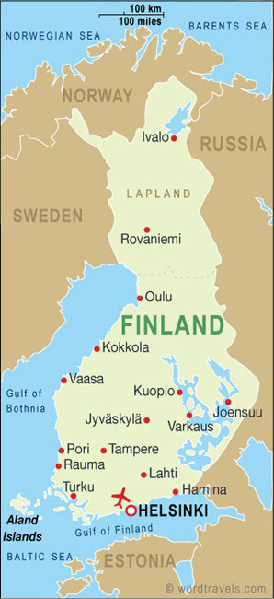

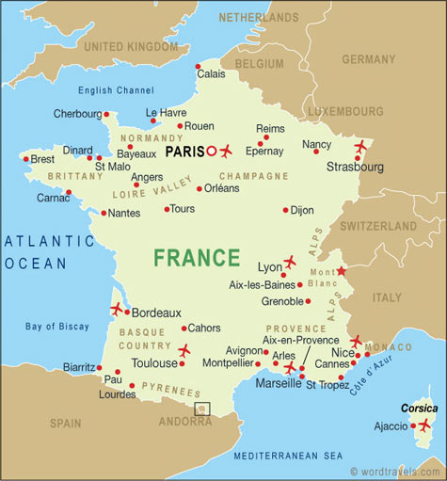
European Dementia Prevention Initiative
www.edpi.org
FINGER Finnish Geriatric Intervention Study to Prevent
Cognitive Impairment and Disability (Kivipelto et al.,Lancet 2015)
Pre-DIVA Prevention of Dementia by Intensive Vascular Care
(van Charante et al., Lancet 2016)
MAPT Multidomain Alzheimer Preventive Trial (Andrieu et al, Lancet Neurol 2017)
Data pooling & joint analyses > 6000 participants
Lessons learned so far:
Timing: start early!
Target populations: Focus on at-risk individuals!
Interventions: Do the right things & Do enough of them!
Notes:
Same on European level….. Cluster randomization study, no sig differences in dementia incidence but positve efefcts in subgropus, high BP to start with. MAPT; some positive effects of the multidomain in subgroups
Should be reporting shortly. MAPT - positive effects for the group receiving multi-domain and omega.
We have build data shairing platform – pooled data
What are the best strategies to prevent?
The necessary and optimal doses of different intervention components still need to be defined.

